Slide 1
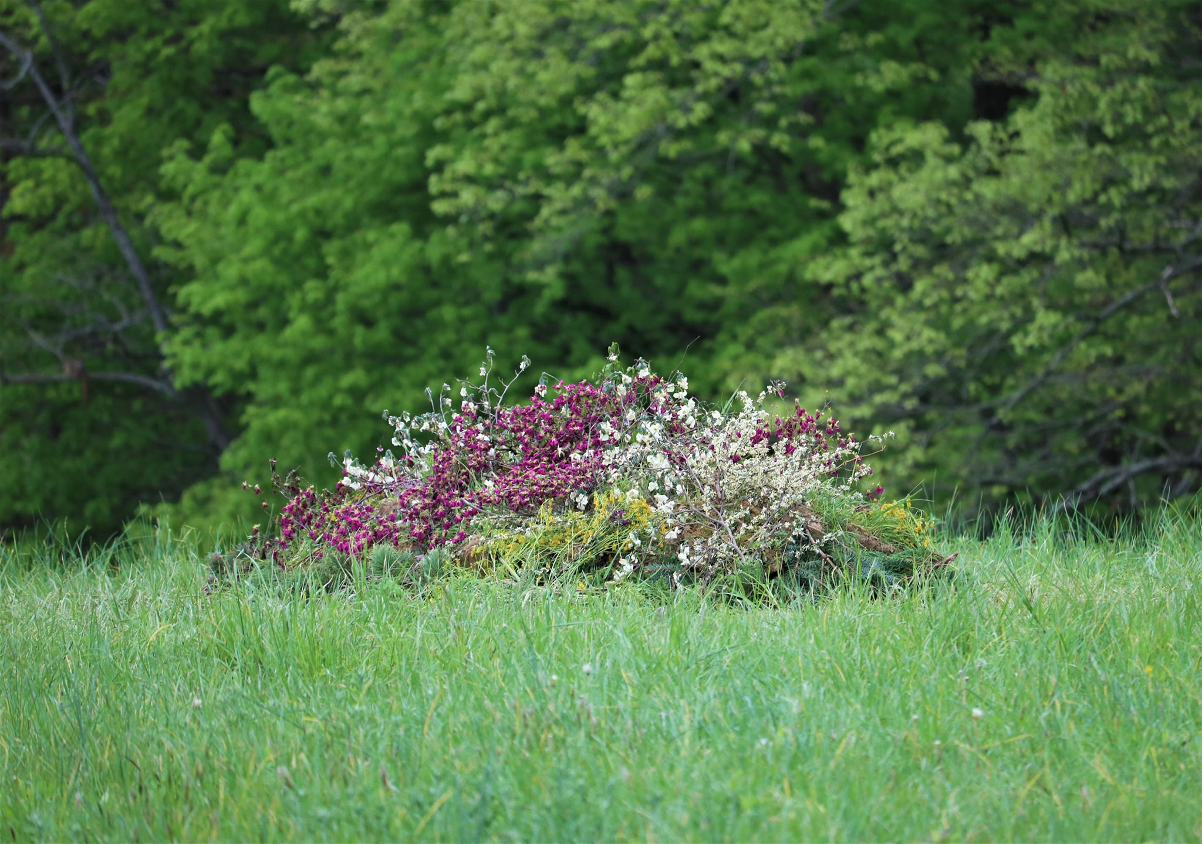
The Greening of North American Cemeteries
Photo courtesy of Donelle Dreese, Heritage Acres, Cincinnati OH
Notes:
Welcome and verbal introduction
[Note: This presentation is intended for general audiences as a first introduction to the basic premises of green burial. You can choose to use all or some of the slides. Additional slides may be added that go into more depth depending on your audience and your goals.]

Slide 2
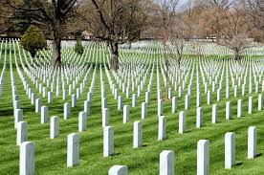
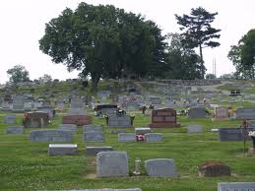
A Little History: The Lawn Cemetery
uses pesticides, herbicides that endanger workers
uses fertilizers that enter the water table, endanger marine life
requires concrete vaults for ease of lawn maintenance
allows embalming fluids that endanger embalmers
is reaching capacity even in rural areas
Notes:
Lawn cemeteries are really a recent invention, stemming out of the Victorian era family plot cemeteries that were hives of activity for the living, with regular picnic lunches after church on Sundays laid out on the graves of the ancestors. Over time, they have become well-manicured, weed-free, bug-free, concrete-filled warehouses for the dead with no other purpose. And they are filling up.

Slide 3
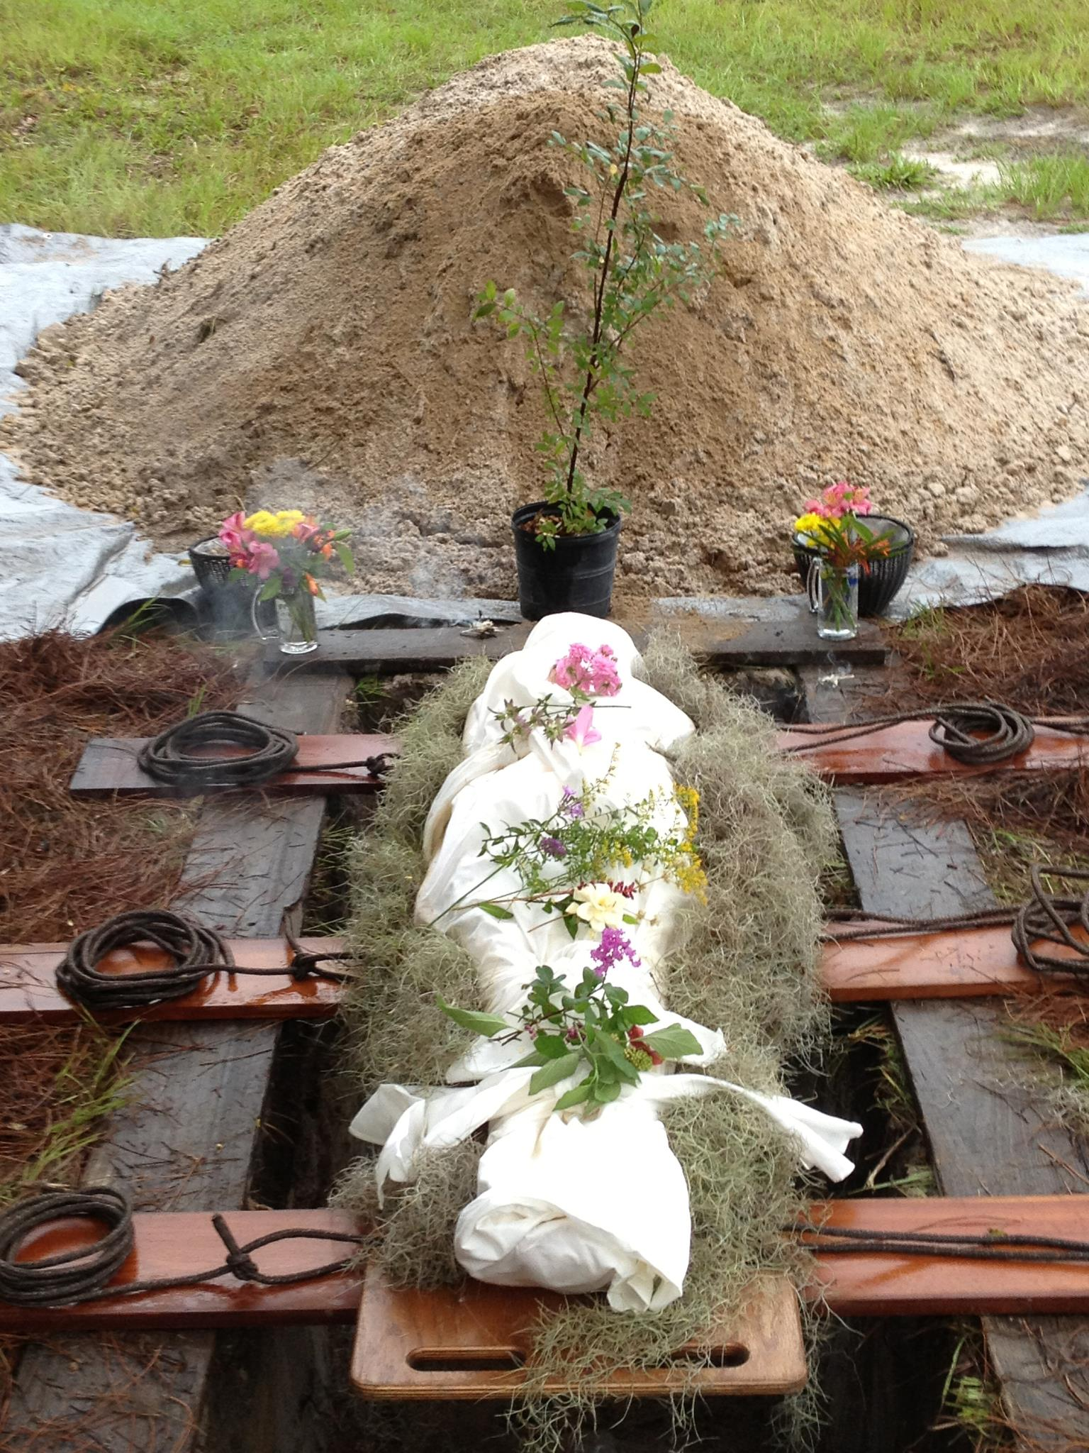
What is Green Burial?
A way of caring for the dead that furthers one or more environmental aims such as:
  the protection of worker health
  conservation of natural resources
  reduction of carbon emissions
  preservation/restoration of habitat
Eliminates use of:
  toxic chemical embalming
  metal or exotic wood caskets
  concrete, fiberglass, or plastic vaults
Encourages:
  locally sourced biodegradable containers
  family participation
  environmentally sound management practices
Photo courtesy of Prairie Creek Conservation Cemetery, Gainesville, FL
Notes:
There are many ways to describe green burial, but the most revealing is the one used exclusively prior to the adoption of vaults: just plain burial. Prior to the Civil War, embalming was not practiced as a matter of course, and vaults were not promoted on the false premise of protecting the body forever or to protect the living, both of which were and are erroneous claims.
Green, or natural, burial in its purest form does the following:
protects worker safety;
conserves valuable natural resources;
reduces carbon emissions;
and contributes to preservation and hopefully restoration of habitat.
By eliminating the use of toxic chemical embalming, metal and exotic wood caskets, and concrete or other vaults, we can go to the grave without contributing to nonrenewable energy expenditures.
We can instead procure caskets and shrouds locally, supporting our local economy, participate as much as we are willing or able in the after-death care to disposition process, and know that we have done so in an authentic, environmentally sound manner.

Slide 4
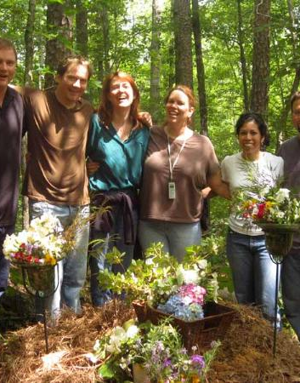
Green Cemeteries:
do not attempt to inhibit decomposition
employ environmentally sustainable practices
encourage philosophy of stewardship
may support land trusts, conservation lands, recreational preserves
Photo courtesy of Ramsey Creek Preserve, Westminster, SC
Notes:
The first goal of green burial is to allow natural decomposition, gifting the body to the earth organically, rather than trying to impede it with chemicals or anaerobic conditions caused by encapsulating in containers or vaults.
The second goal is to run the cemetery in environmentally responsible and sensitive ways, treating it as a place where life goes on rather than as a warehouse for the dead and the non-biodegradable artifacts left behind.
By offering community supporting activities above ground, such as recreational, educational, agricultural, or community-centered events, green cemeteries become places to honor the dead while celebrating the living and contributing to an ethic of stewardship.
Some green cemeteries are affiliated with land trusts or other entities that provide governance and financial support while burials creating a revenue stream to support above ground activities.

Slide 5
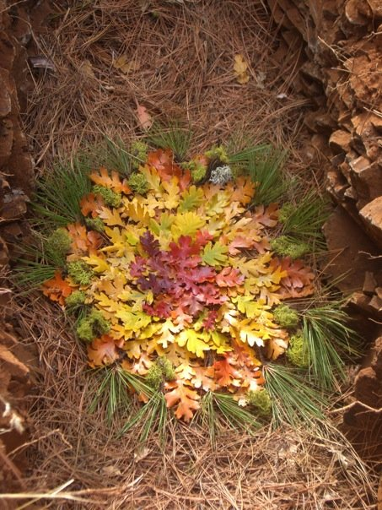
Green Burial Reform Drivers
Who wants a green burial?
  transcends all socio-economic-political boundaries
  eco-conscious consumers
  babyboomers
  members of spiritual communities
And why?
  environmental stewardship
  economics
  aesthetics
Photo courtesy of White Eagle Memorial Preserve, Goldendale, WA
Notes:
Those involved in the green burial movement strive to make green burial open to all, regardless of cultural boundaries. Two groups – babyboomers and spiritual communities – are leading the way in demanding a return to environmentally conscious after death practices. Burial, with its attending rituals, and green burial in particular, appeals to people as a responsible means of acknowledging the loss to the family and to the community.

Slide 6
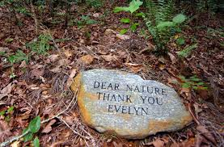
Why Choose Green Burial?
sense of place
religious doctrine
individual preference
environmental impact
cost
authenticity
intrinsic value
invitation to participate
Photo courtesy of Ramsey Creek Preserve, Westminster, SC
Notes:
By and large, people are looking for sense of place, of being able to think of their loved ones in a familiar setting, one of peace and comfort. Burial is also in accord with certain religious doctrine, particularly that of resurrection, where full body is necessary. More people are considering the environmental impact as part of their exit plan, which they want, above all, to be in alignment with their core values in life. Cost may play a small or a large part in their decision as well. Green burial offers all of these, plus the invitation to participate as much as desired during the process, from after-death care to shoveling in the dirt at burial.

Slide 7
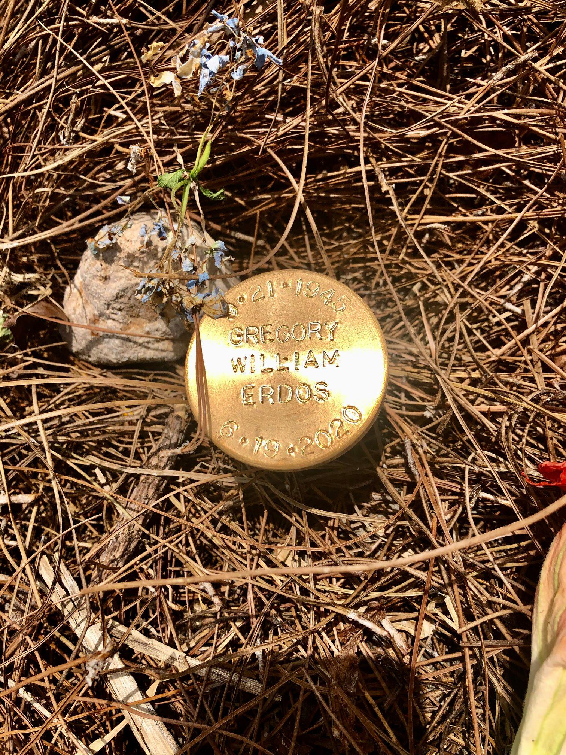
Types of Green Burial Cemeteries
Hybrid burial grounds
in conventional cemetery
no vaults
biodegradable containers
Natural burial grounds
in green cemetery
prohibits toxic chemicals, non-organic caskets, vaults, non-native markers
Conservation burial grounds
on easement or land trust
land preservation with burial fees creating revenue stream to further conservation, restoration, recreation paths
Photo courtesy of Prairie Creek Conservation Cemetery, Gainesville, FL
Notes:
The Green Burial Council certifies green cemeteries at three levels. Describe all three.

Slide 8
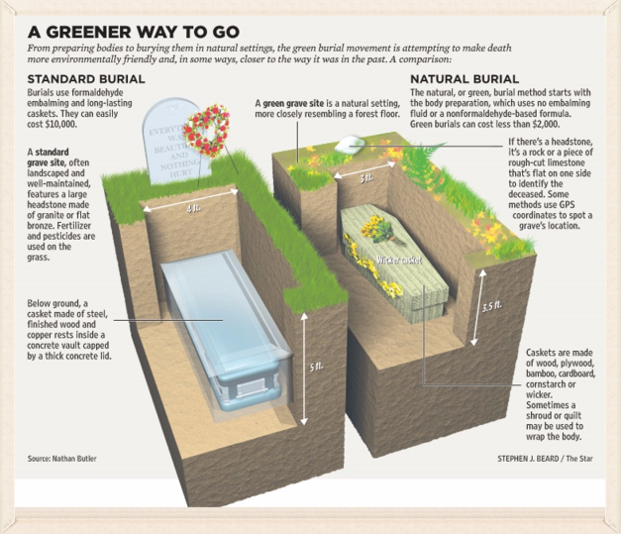
Anatomy of a Green Burial Grave
Notes:
In this infographic you can see the optimum burial depth in contrast to the current practice. This allows for rapid decomposition. It also allows the bodies’ nutrients to provide benefit to the vegetation above the surface of the earth.

Slide 9
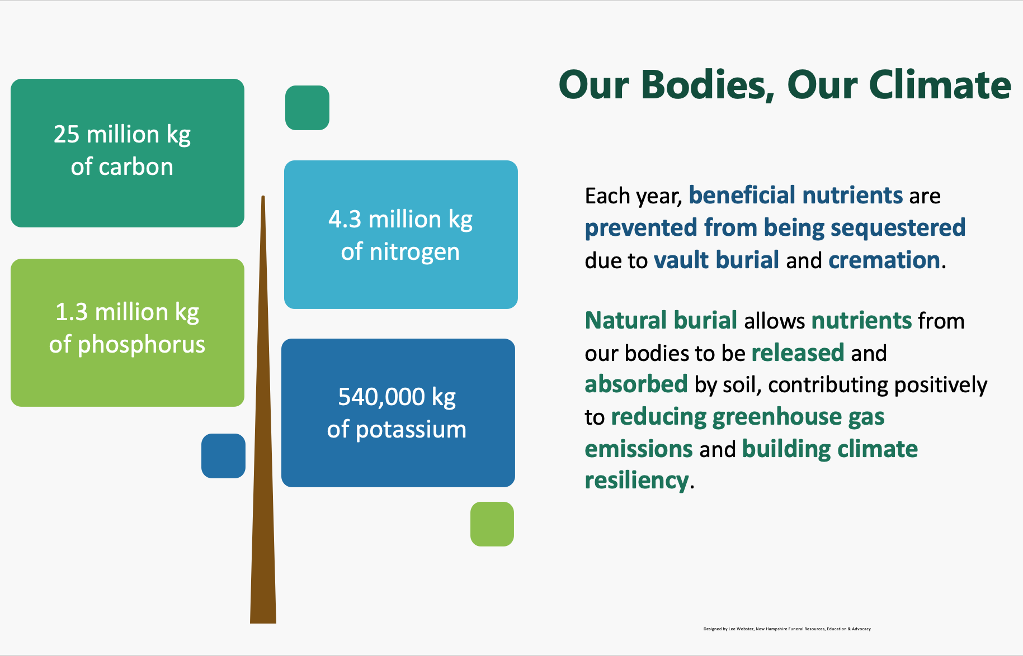
Estimates by D.O Carter, PhD, Forensic Taphonomist
Notes:
It’s one thing to stop contributing to the pollution cycle through vault burial and cremation. But how might we begin to look at what we contribute to the planet through natural burial?

Slide 10
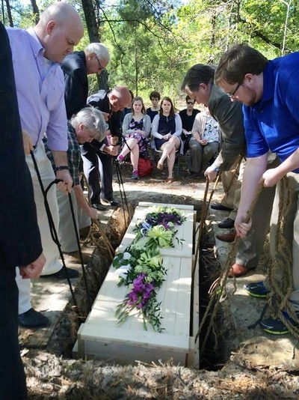
The Return to Ritual
Feeds the human spirit
Acknowledges change in the community
Deepens connections
Tells the personal story
Reclaims ritual shroud practices
Provides the opportunity for graveside service
Photo courtesy of Ramsey Creek Preserve, Westminster, SC
Notes:
Ritual is indeed central to the human spirit. It is woven into the fabric of our daily lives. We have rituals or ceremonies when babies are born, graduations, birthdays, religious. End of life ritual is no different.
Every culture has a form of ritual to mark the end of life. Stop for a minute & consider that most of our clients, by nature, are older ...... These are the folks, for the most part, that were raised in a faith based society. Even if they are not currently church oriented, at a time of crisis one tends to return to the familiar and comfortable. The baby boomers & younger are not as faith based, and many times are more apt to look for “personalization’ or “experience”
This is where we are today – the familiar and comfortable giving way to new forms of experienced based ritual.
While direct cremation rates rise, ritual observation decreases. The result we are hearing is that people are experiencing PTSD-like symptoms from not having had a funeral. Green burial is helping bring people back to finding ways of making meaning around death.
For many families, shrouding and casketing has ritual significance—invite them into the process. Ritual shroud wrapping was once an essential part of the funeral process with meaning in every step, and it is on the rise again.
And most importantly, in-house funeral observances and graveside services help funeral providers recoup income that previously may have been lost to cremation.

Slide 11
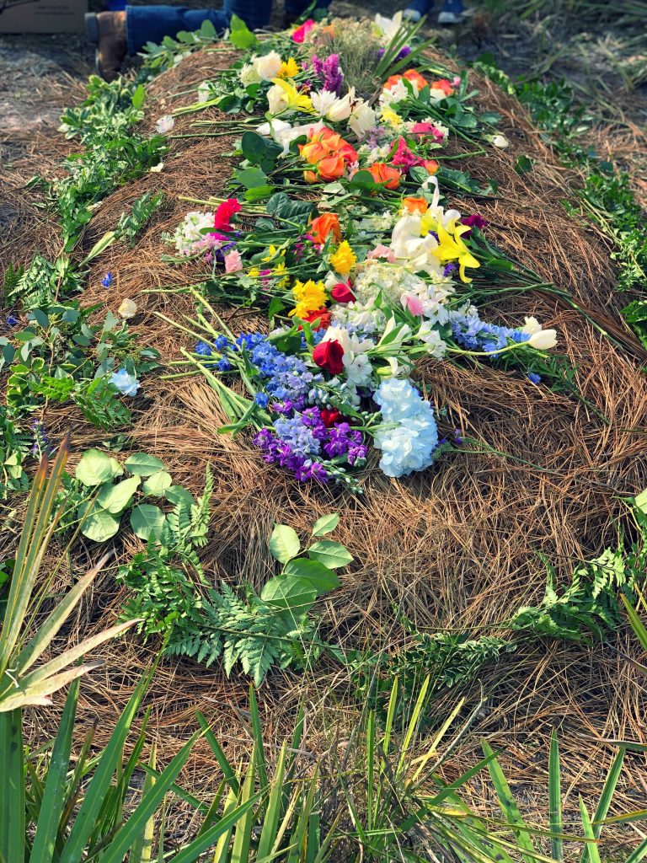
The Growing Demand
1998 1st US green cemetery
More than 450 green cemeteries as of 1.24 (Green Burial Cemeteries in the US and Canada, nhfuneral.org)
Surveys say interest is rising:
  Kates-Boylston 2021 green funerals*91%
  Kates-Boylston 2021 green burials* 84.4%
  NFDA 2022 60%
  NFDA 2018 53.8%
  US Catholic 2011 80%
  FAMIC Harris Poll 2015 64%
  Kates-Boylston 2008* 43%
  AARP 2007 42%
  * American Funeral Director Magazine
Photo courtesy of Heartwood Preserve, Trinity, FL
Notes:
Since 1998, more than 450 cemeteries at all levels have been developed in the US and Canada. This growth, particularly in established conventional cemeteries, represents a radical shift in thinking about how we manage not only death but land and resources. It also speaks to the desire to have green burial space in locations where everyone can call up that sense of place we described earlier.

Slide 12
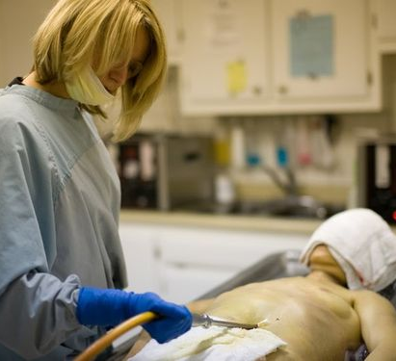
Mythbusting
Embalming
  not legally required
  policy for funeral home viewing
  preserves body for up to 2 weeks
  has no protective properties
  body fluids are disposed in septic systems and wastewater treatment plants
Vaults
  not legally required by any state
  policy of lawn cemeteries for maintenance reasons
  have no protective properties
Notes:
Before we can address the positive benefits of green or natural burial, we need to lay to rest some prevailing notions about the way we do death in America. Don’t be embarrassed if you are among the majority of people who have long believed either of these myths. Listen up and the truth shall set you free.
Embalming bullets
Vault bullets
Now that that is out of the way, let’s move on to the good stuff

Slide 13
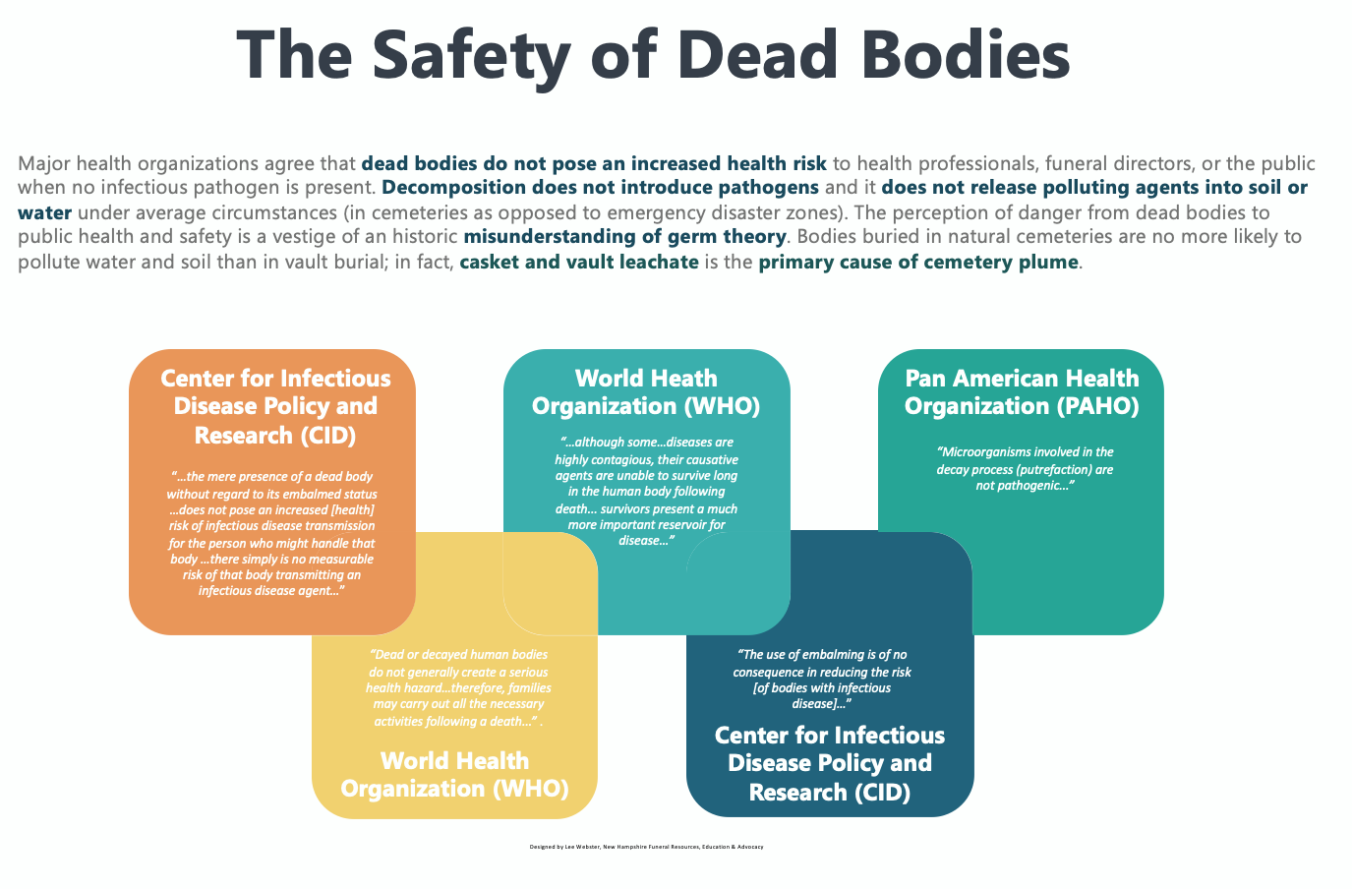
Notes:
In case it comes up – good to be armed with the facts
Survival rates: Hep B = 7 days; HIV = minutes to hours; Hep C 3 weeks; HCV 26 hours to 4 days —Centers for Disease Control (CDC)
Ebola, Creutzfeldt-Jakob are less contagious in soil; other diseases are no longer infectious —Centers for Disease Control (CDC)

Slide 14
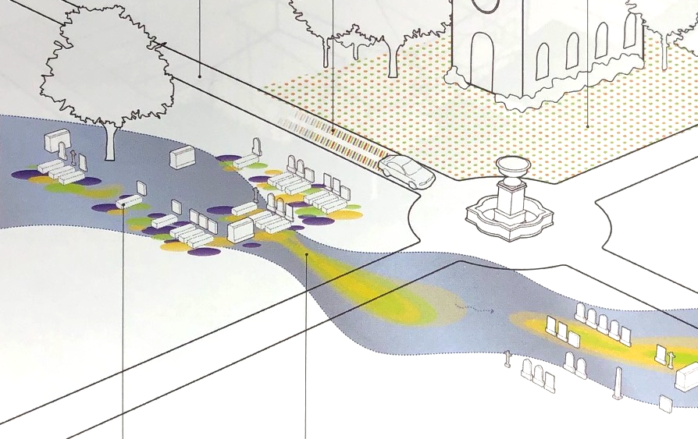
Public Health and Safety
  “Microorganisms involved in the decay process (putrefaction) are not pathogenic...” —PAHO
  WHO, CDC, and CID agree: Bodies without pathogenic conditions are not dangerous to the public
  Scientific research shows that what is buried with the body is what pollutes, not the bodies
Artist’s Rendering of Cemetery Contamination Plume, Phyto by Kennen and Kirkwood
Notes:
How we think about public health and safety around burial matters. And research over the past decade has helped us understand that not only are dead bodies not automatically dangerous, we are beginning to identify what IS.

Slide 15
Lawn Cemetery Health Risks to the Environment
Fertilizer
Algae plume in waterways
Decreased oxygen in water
Decimation of aquatic food sources
Increased ammonia
Chemical burn to crops
Soil and mineral depletion
Herbicides
Fast, broad-spectrum burndown of weeds affecting:
Neighboring or incidental foliage
Fruit and vegetable crops
Pesticides
Spray drift causing neighboring crop deformity and diminished productivity affecting:
Fruit crops
Apiaries
Vineyards
Vegetable crops
Notes:
Nitrate, potassium, phosphates
decreasing dissolved oxygen, killing aquatic food sources, increasing ammonia
Fruit crops
Apiaries
Wine vines

Slide 16
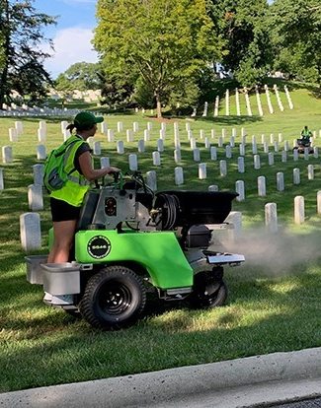
Worker Safety Concerns
Embalmers/funeral directors
    13x higher risk of early death Slocum and Carlson, Final Rights
    8x higher risk of leukemia 11.24.09 Journal of National Cancer Institute
    3x higher risk of ALS 7.13.15 Journal of Neurology, Neurosurgery & Psychiatry
    Other disease abnormalities 1990 Journal of American Industrial Medicine
    Chronic Obstructive Pulmonary Disorder (COPD)
    Neurological diseases, Parkinson’s Disease
Maintenance and factory workers
  COPD, respiratory diseases
  Neurological disorders
  Cancer
Notes:
Let’s zero in on one of the most important issues for you: health and worker safety. As you no doubt know, formaldehyde-based embalming fluid also has traces of benzene, sulfur dioxide (respiratory irritant), and hydrochloric acid (acid rain).
*This results in a cumulative 13% higher risk of contracting terminal diseases than the general population. Specifically, there is an 8 times higher risk of leukemia, a 3 times higher risk of ALS, and a general pool of neurological disturbances. We are hearing that more and more embalmers are choosing to use non-formaldehyde based fluids for their own safety, not because of customer demand. In fact, we haven’t heard yet from a funeral director who has prepped a body for green burial whose family has asked for it.
*Actual figures supporting the claim that maintenance workers in conventional cemeteries have increased risk of COPD and other respiratory diseases, an increased risk of neurological diseases, and cancer are hard to find, but they are accepted as truth within the medical community. Let’s face it, more research will be done on you than on the guy who runs the lawnmower.
*Same thing for factory workers, though OSHA and the federal government have scads of health information about them. We have yet to find it broken down by distinct product manufacturing, but we are trying to learn more about what chemical exposure and other health risks are present for factory workers making funeral goods exclusively.
In any case worker safety is a major concern.

Slide 17
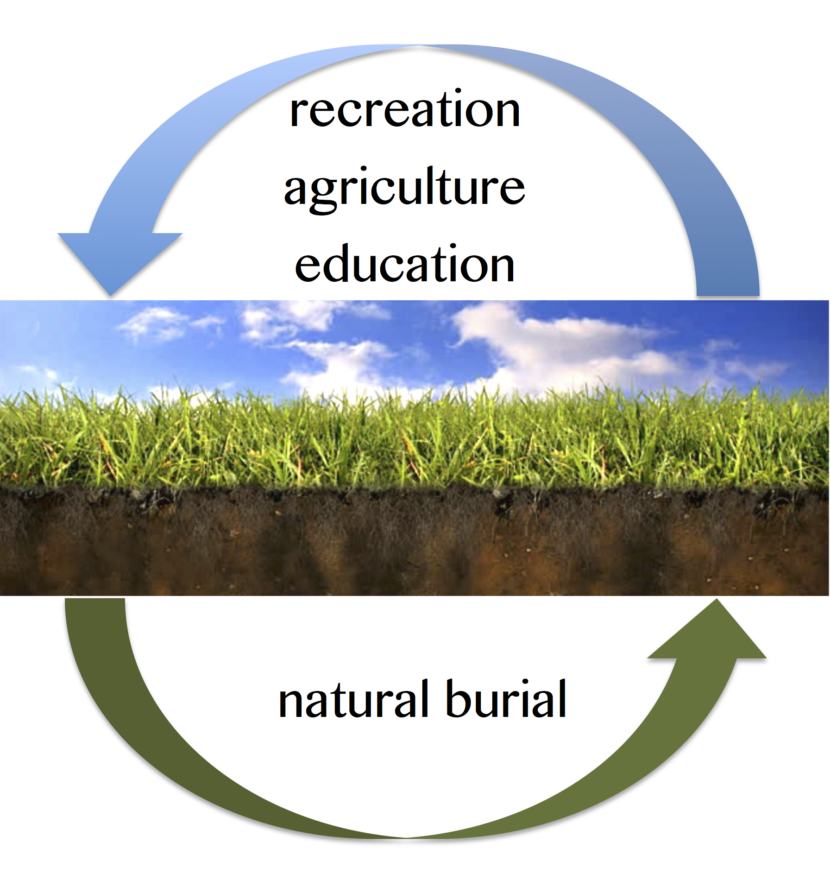
Scientific Reports
3 – 4 foot depth optimum temp, moisture level for rapid, aerobic decomposition
Shallow burial optimizes land otherwise unusable
Surface humus buffers soil pH, binds metals
Studies identify ‘furniture’ as a pollutant rather than bodies in vault cemeteries
No animal disturbances reported in green cemeteries – 18-24” smell barrier prevents, as does mounding
Image courtesy of Lee Webster, NHFREA nhfuneral.org
Notes:
Furthermore, the scientific community supports green burial with these observations:
Shallower burial depth (3 to 4 feet) provides the optimum temperature and access for natural agents (beetles and other microbes) for rapid, aerobic decomposition.
It also means that we can use land for burial that would otherwise be unusable.
Soil is the greatest filter known – optimum soil conditions create an environment that binds heavy metals and other toxins that bodies accumulate over the course of our lives. This does not happen in the anaerobic conditions created by closed burial.
The few studies available that seek to measure soil and water contamination in or near cemeteries have focused on disaster sites, not active cemeteries. The general conclusion is that the known polluting agents can be attributed to casket and vault leachate, not bodies. Further testing in actual green burial cemeteries is being developed.
No animal disturbances have been reported. We are just not that delicious.

Slide 18
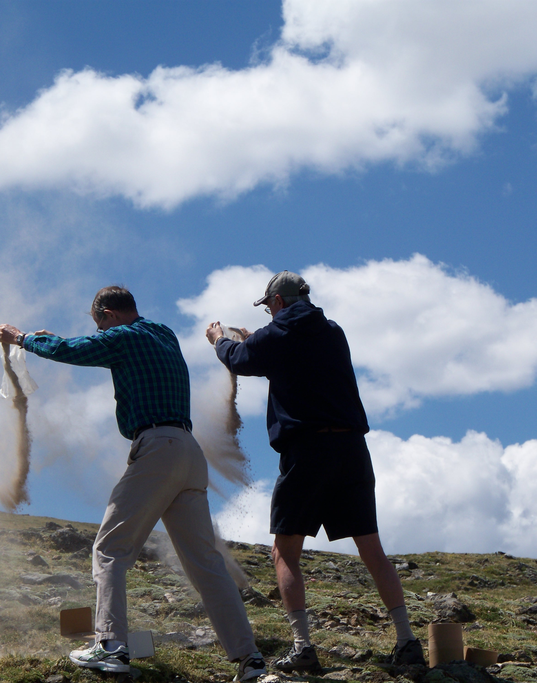
Eco Costs of Cremation
Uses fossil fuels 2-3 hours at 1700 - 1900° F
Releases mercury and other elements into air & water
Byproduct emissions of nitrogen oxide, dioxins, particulates – acid rain
Radiopharmaceutical contamination
25,000 metric tons carbon in 2017; 250 lbs. pp
Final product = calcium phosphate and sodium with an extremely high pH (11.8) (200 – 2000x what plants can tolerate)
Phosphorus run-off causes algae bloom, death to marine life
Notes:
The statistics speak for themselves. The mercury comes from our teeth fillings and other heavy metals we accumulate over a lifetime. Radiopharmaceuticals refers to activated radiation from recent treatments for breast cancer or prostate cancer “seeds” that are available during cremation, showing a slight rise in danger for crematory operators.
Cremated remains are not nutrient rich in ways that are available for healthy plant life. The final product – calcium phosphate and sodium – is so “sweet” in pH it is detrimental to fragile flora. And cremated remains are dense, made of pulverized bone, and can crush or smother whatever they land on with enough mass. The sodium also prevents plants from flourishing – roots will find a way to grow away from salt every time.

Slide 19

Shop Local — Avoid Greenwashing

Slide 20
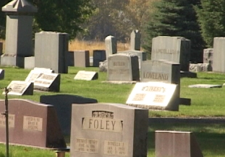
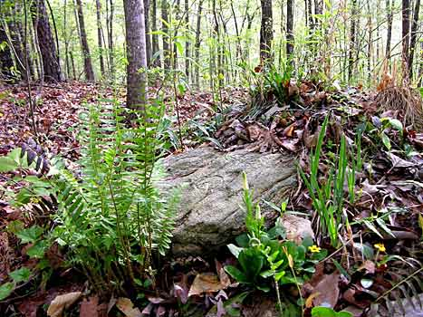
We Have a Choice
where death is
where life goes on
preserves natural ecosystem while supporting recreation, research, education, agriculture, forestry
destroys open space forever
Photo courtesy of Ramsey Creek Preserve, Westminster, SC
Notes:
As it says

Slide 21
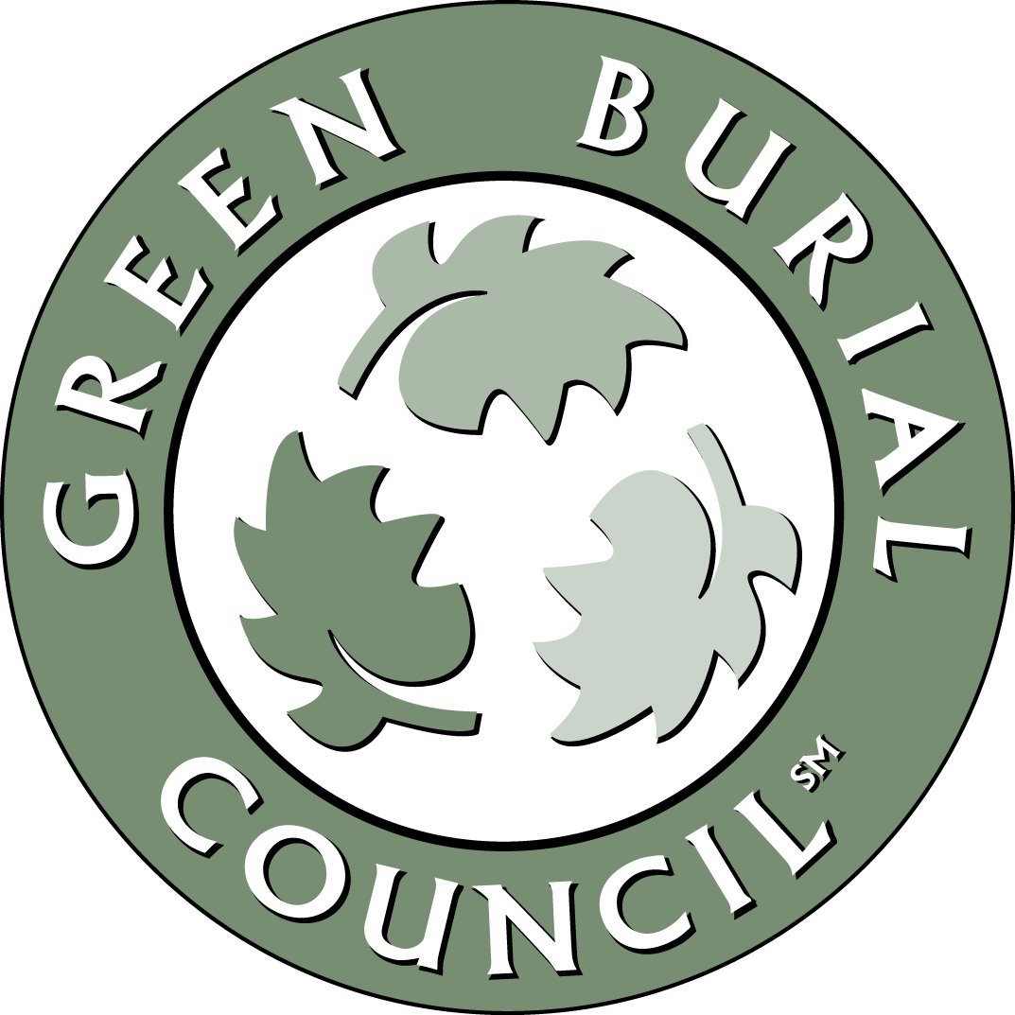
Your Call to Action
  Become a Friend of the GBC
    Join the movement to create change in your community
    Get access to tools that will help you spread the word
  Read
  10 Things You Can Say or Do to Promote Green Burial (GBC)
  Start-Up Tips for Green Burial Cemetery Operators (GBC)
  On the Way to the Green Burial Cemetery: A Handbook for Families (GBC)
  Reach Out
  Contact cemetery trustees, owners to request change
  Present to libraries, civic groups, churches, events
Notes:
What can you do? Here are some ideas.
Becoming a Friend of the GBC taps into the base of fellow green burial advocates so that you can access and share tools to help in your work educating others. Just becoming a Friend is a way to support the work of the GBC in its own advocacy work.
Becoming an advocate means opening up communication so that your message can be heard by those who are in a position to create change, such as cemeterians, town officials, funeral directors, policymakers, and many others. Here are some articles to read that will help you prepare to become a green burial advocate.
Once you have all the facts and the tools, begin creating a coalition of interested stakeholders in your community. Don’t be afraid to talk about it – more people are interested than you know. After all, we all have skin in this game.
What thoughts and ideas do YOU have? Get people talking right now!

Slide 22
Where to Find More Information
What Every Funeral Director Needs to Know About Green Funerals
On the Way to the Green Burial Cemetery: A Handbook for Families
Real Answers to Questions Real People Ask About Green Burial
Why Green Burial is a Veteran’s Issue
To Lie Down in Green Pastures: the Catholic Church leads the way in green burial
Sample Website Language for Funeral Homes Offering HF & GB Assistance
Suggested Goods and Services List for Funeral Directors

Slide 23
For More Information
<Your name>
<Contact information>
<What you offer>
<What other groups or nonprofits are in support of this work>
Green Burial Council
www.greenburialcouncil.org
888.966.3330
Slide presentation prepared by Lee Webster, updated May 2022
For more information and teaching tools, write nhfrea@gmail.com
Notes:
Add your information here, with website, photo and logo above the GBC material

